Slide 1

HomeEase
Hashir Hamid — CIIT/FA22-BSE-139/ATD
Aman Ullah Khan — CIIT/FA22-BSE-074/ATD
Umar Saeed — CIIT/FA22-BCS-041/ATD
Supervisor: Sumair Khan
Department of Computer Science
COMSATS University Islamabad, Abbottabad Campus

Slide 2
Agenda of the Presentation
Brief Introduction
Scope
Functional Requirements
Non-Functional Requirements
User Goals
Use Cases
Use Case Diagram
Class Diagram
Sequence Diagram
Activity/State Machine Diagram
Decision Table
Schedule (Gantt Chart)
Tasks for 1st Iteration(or 30%)
Details of 2nd Iteration (60%)
Conclusion

Slide 3
Brief Introduction
HomeEase is a mobile-based platform designed to connect households with domestic and home-care workers such as maids, cooks, cleaners, nannies, and caregivers. In Pakistan, domestic worker hiring is commonly managed through personal references, neighbors, relatives, or word of mouth. This informal process creates issues related to trust, safety, availability, pricing clarity, communication, and service quality.
HomeEase provides a structured digital solution where household users can search for nearby workers, view profiles, compare services and rates, send booking requests, and submit reviews after completed services. Worker users can create professional profiles, list their services and expected charges, manage availability, receive booking requests, and build a reputation through ratings. Admin users will use a lightweight web dashboard to verify workers and monitor basic platform activity.

Slide 4
Scope
Mobile app for household and worker users.
Login page with role choice for household and worker users.
Household registration and profile setup.
Worker registration and profile setup.
Worker service categories and expected pricing.
Worker availability and verification status.
Local search using city/area and service category filters.
Worker list and worker detail screens.

Slide 5
Scope
Booking request creation.
Worker booking request overview.
Booking status tracking.
Basic service agreement/contract generation after worker acceptance.
Manual payment tracking through EasyPaisa/JazzCash receipt upload and worker confirmation.
Rating and review after service completion.
Dispute/report creation linked with bookings, payments, or service issues.
Notification list for important updates.
Admin web dashboard for login, worker verification, user overview, booking overview, agreement overview, payment overview, and dispute/report handling.

Slide 6
Out of Scope
in-app wallet processing.
Payroll management.
Government, NADRA, or police database verification.
Full legal employment contract enforcement.
Transportation or logistics for workers.
Video calling.
Household or worker web portals.
Advanced analytics dashboard.

Slide 7
House Hold User Functional Requirements
FR-01: User Registration
FR-02: User Login
FR-03: Role Choice on Login
FR-04: Role-Based Access
FR-05: Household Profile
FR-06: Worker Profile
FR-07: Service Categories
FR-08: Pricing Information
FR-09: Availability managemnt
FR-10: Worker Verification
FR-11: Search Workers
FR-12: Filter Workers
FR-13: View Worker Profile
FR-14: Create Booking Request
FR-15: Booking Response
FR-16: Booking Status

Slide 8
Worker User Functional Requirements
FR-17: Service Agreement
FR-18: Agreement Access
FR-19: Manual Payment Details
FR-20: Payment Receipt Upload
FR-21: Payment Confirmation
FR-22: Payment Status
FR-23: Dispute Creation
FR-24: Dispute Resolution
FR-25: Rating and Review
FR-26: Notifications
FR-27: Basic Communication
FR-28: Role-Based UI Flow
FR-29: Admin Web Login
FR-30: Admin User Management
FR-31: Admin Booking Overview
FR-32: Report/Dispute Handling

Slide 9
Non-Functional Requirements
Usability Requirements
The system shall provide a simple, intuitive, and easy-to-navigate UI across mobile and web.
The system shall show clear success and error messages for all user actions.
The onboarding process (registration + login) shall be quick and require minimal steps.

Slide 10
Non-Functional Requirements
Performance Requirements
All major screens and search results shall load within seconds.
Real-time chat messages shall deliver with a minimum delay
The system shall scale to support a large number of concurrent users without degradation.

Slide 11
User Goals
House Hold User Goals
a user-friendly dashboard where workers and be searched based on categories and filter them
Easily find verified workers and the services they are offering
view a services of liking and sending a booking details like time date and address
View agreement terms and conditions
Submit payment receipt for booking confirmation
Rate workers service and provide feedback
Raise a dispute in case of any conflict

Slide 12
User Goals
Worker User Goals
Register themselves and get verified on the platform.
Add profession details and pricing
View active jobs and booking requests
Confirm booking after verifying payments
Set work availability status and working days
Receive ratings after completing tasks

Slide 13
Use Cases
UC-1: Register Account
UC-2: Log In
UC-3: Create Worker Profile
UC-4: Verify Worker Profile
UC-5: Search Workers
UC-6: Send Booking Request
UC-7: Accept or Reject Booking
UC-8: Submit Payment Receipt
UC-9: Submit Rating and Review
UC-10: Raise Dispute
UC-11: View Service Agreement
UC-12: Confirm Payment Received
UC-13: Admin Booking/User Overview

Slide 14
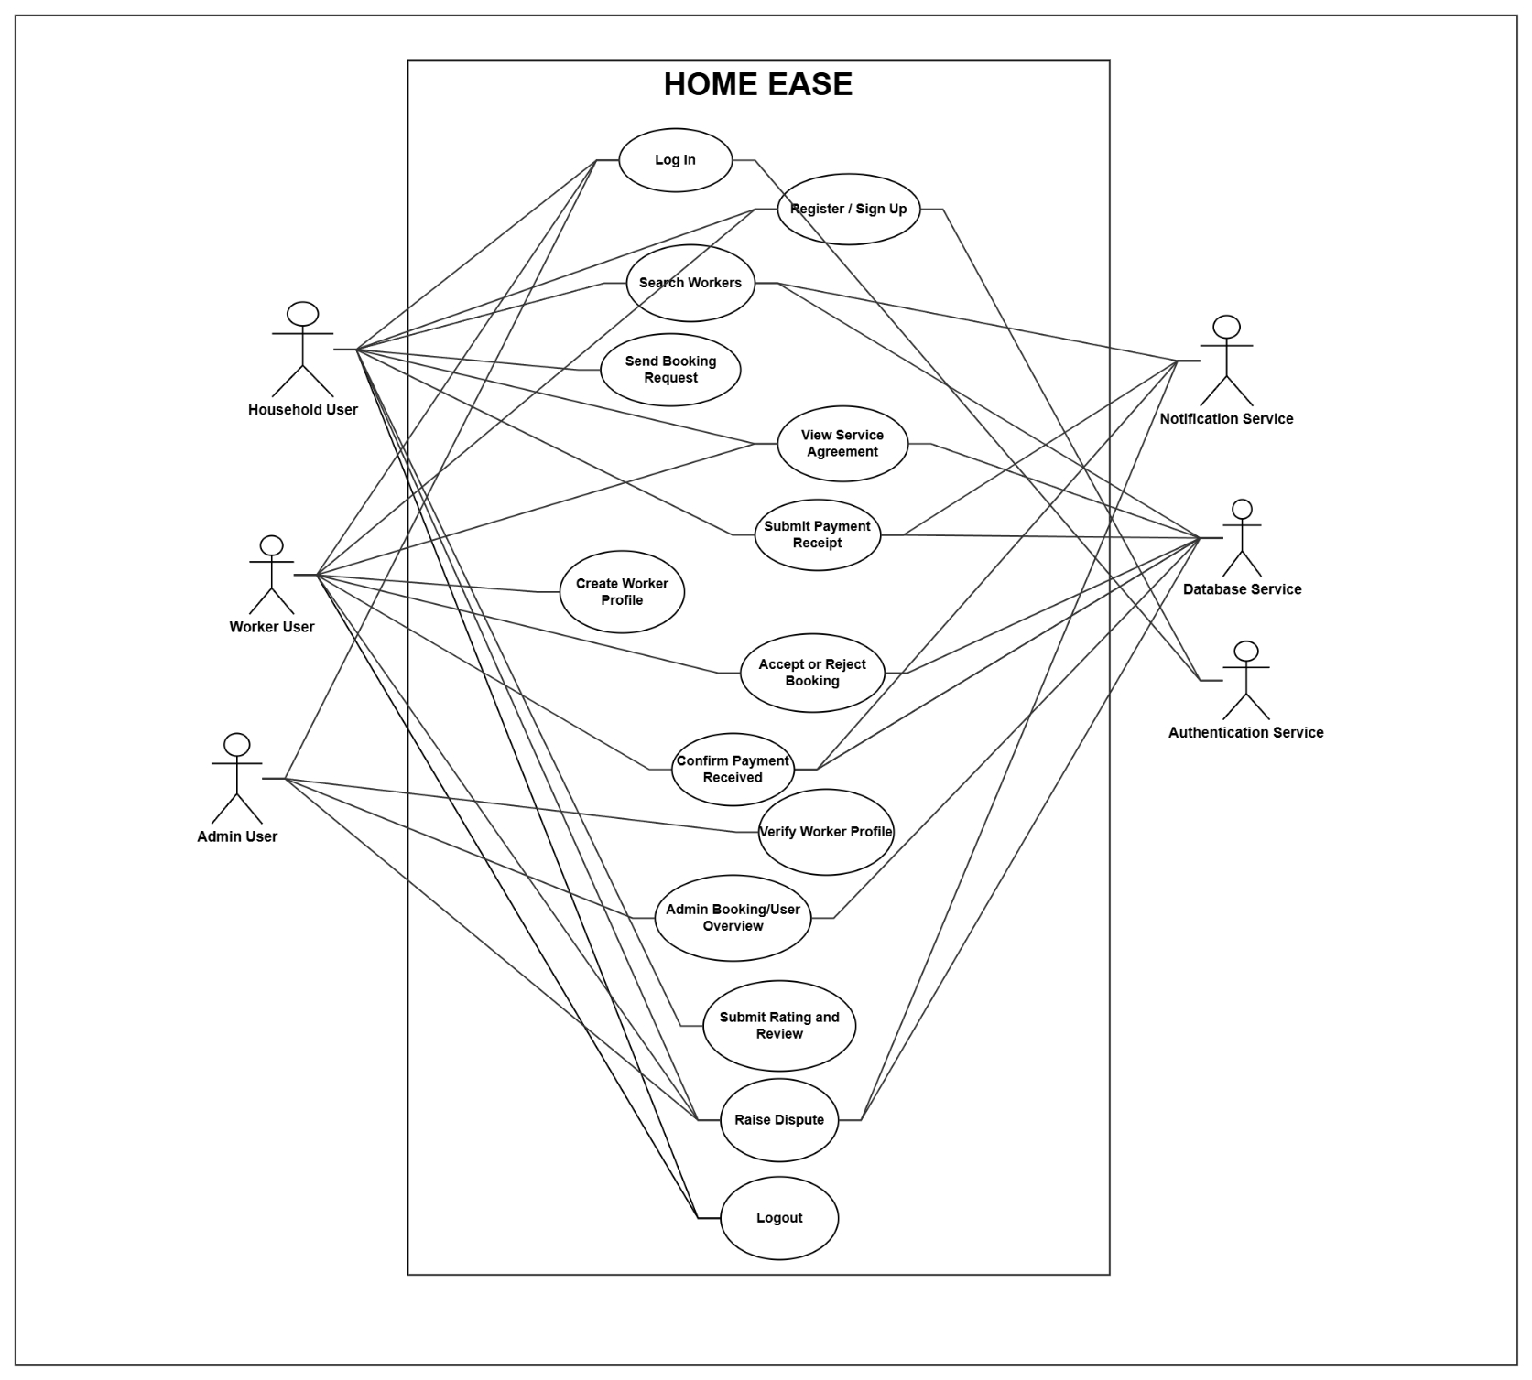
Use Case Diagram

Slide 15
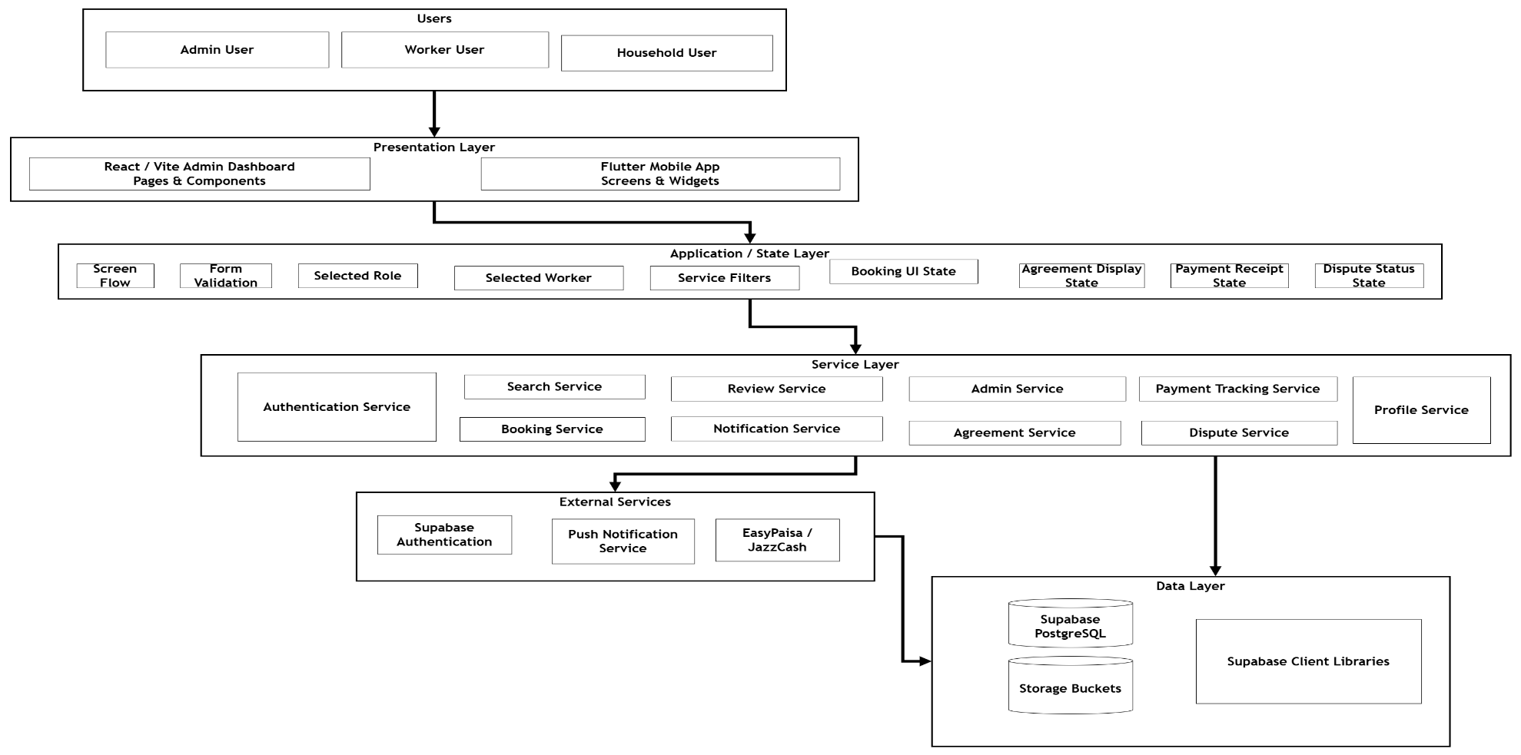
Archtecture Diagram

Slide 16
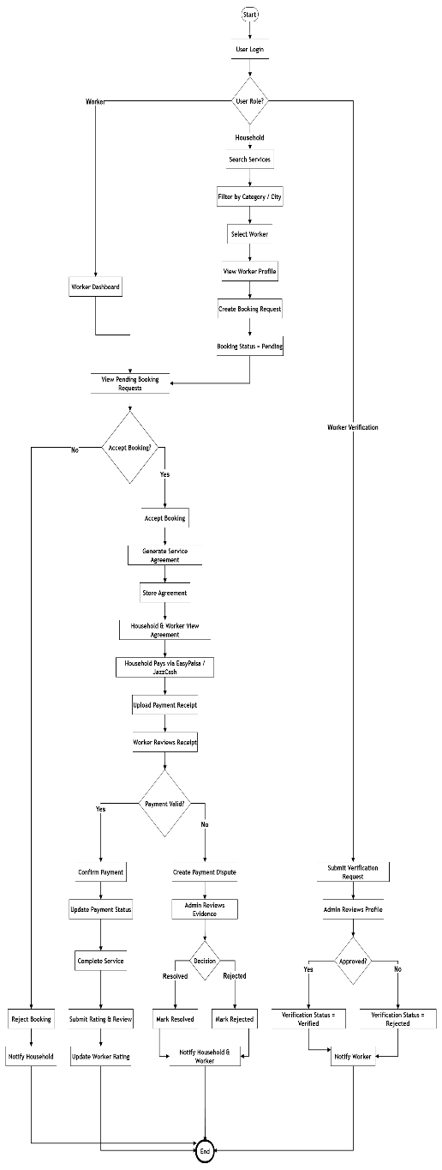
Activity Diagram

Slide 17
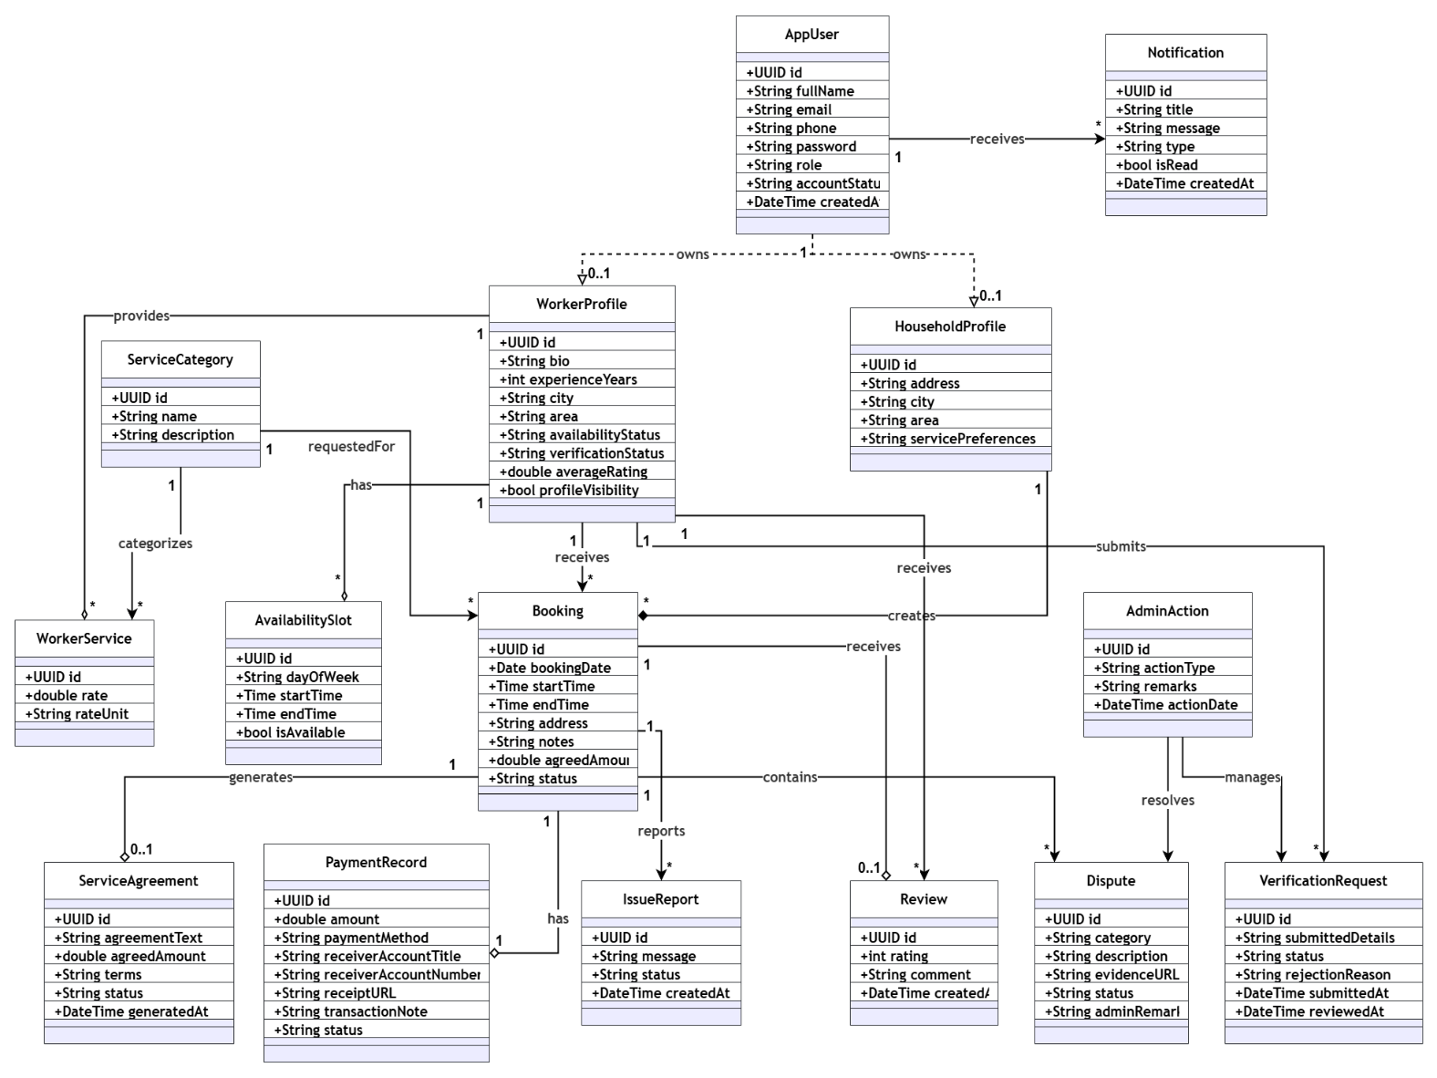
Class Diagram

Slide 18
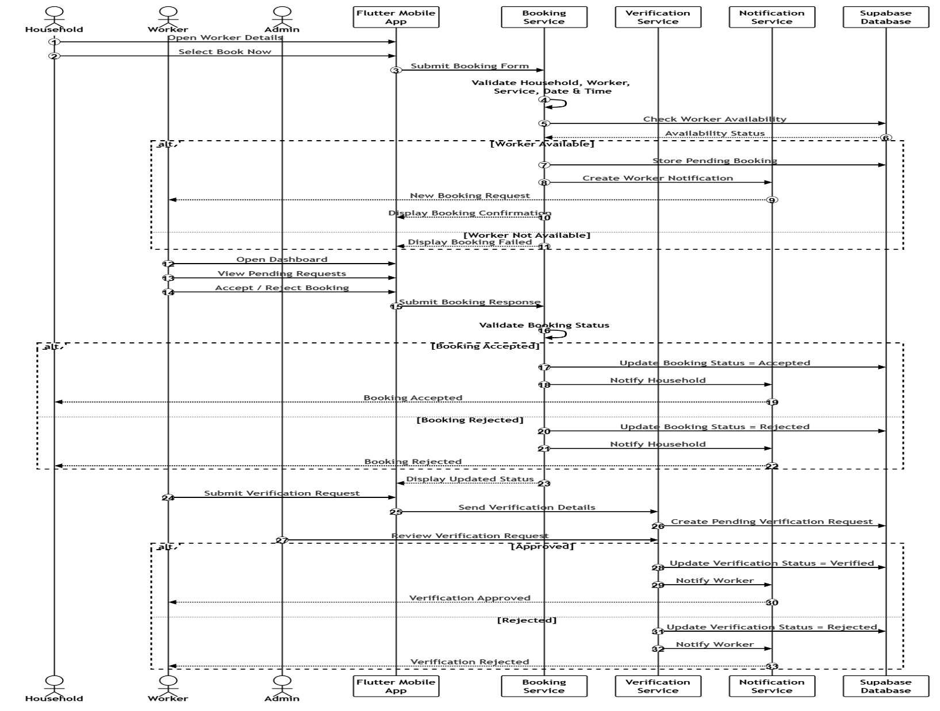
Sequence Diagram

Slide 19
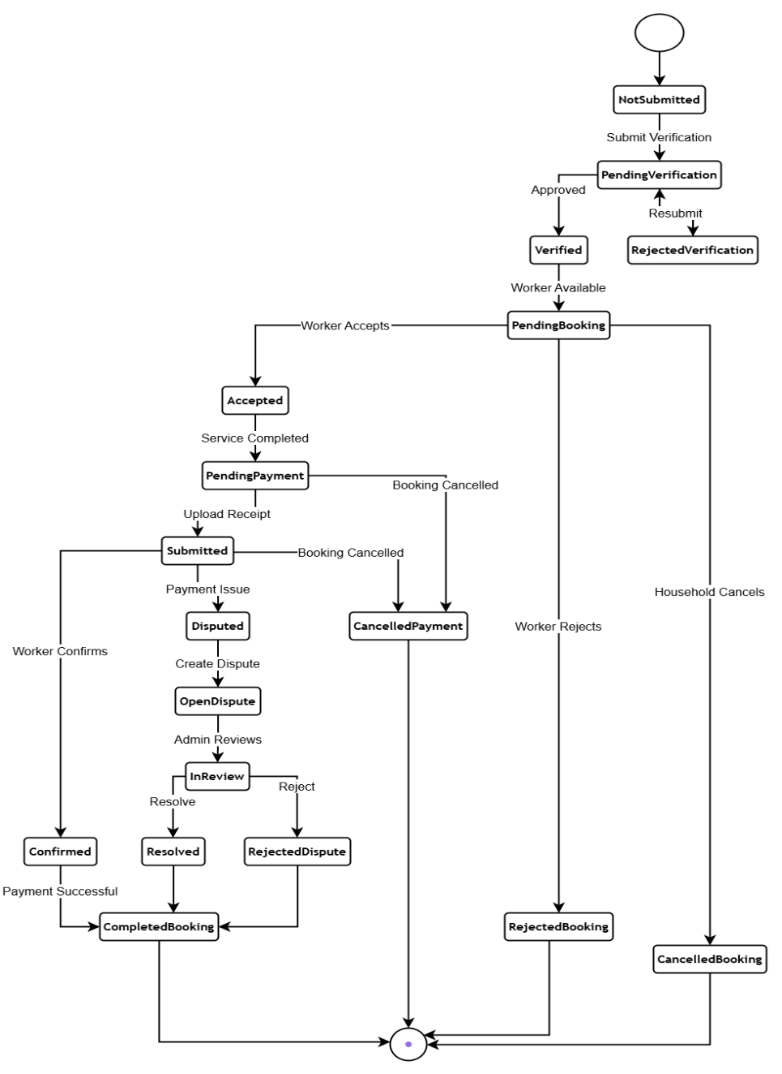
Activity/State Machine Diagram

Slide 20
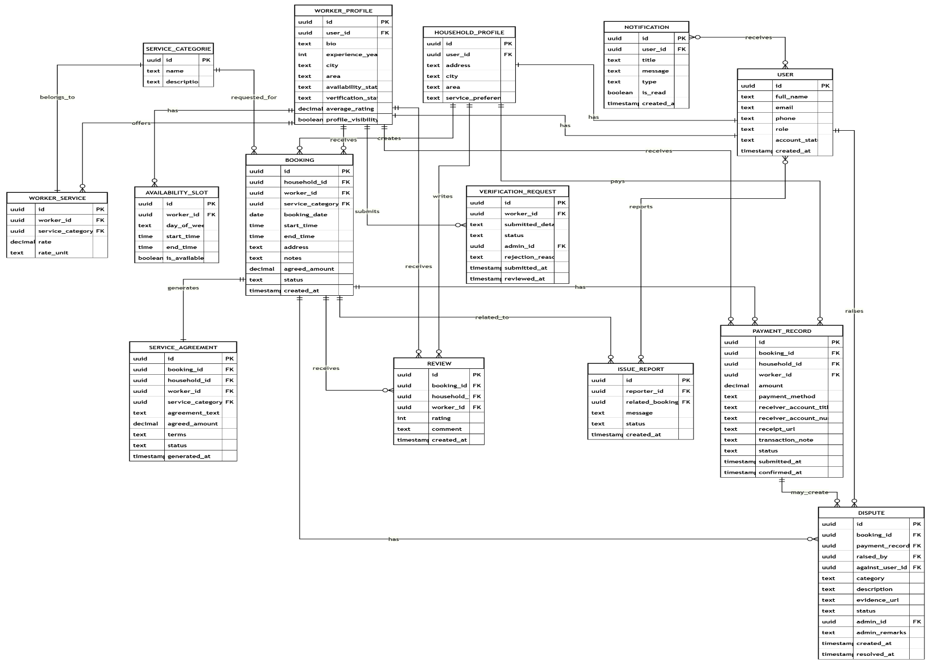
ER Diagram

Slide 21
Decision Table, Pseudocode
Use Case | Condition | Action Taken by System
UC-1: Register Account | New user submits valid registration info (name, phone, role selection) | Creates entry in USERS, initializes corresponding 1-to-1 role profile (HOUSEHOLD_PROFILES or WORKER_PROFILES), and routes to profile configuration.
UC-2: Log In (Active Account) | User submits valid credentials and account status is Active | Validates session, loads authorization token (enforcing Supabase RLS policies), and routes to the role-specific landing screen.
UC-2: Log In (Suspended Account) | User attempts login, but account status is Blocked/Suspended | Blocks session initialization, restricts token creation, and displays account suspension notice.
UC-3: Manage Worker Profile & Availability | Worker updates bio, skills, pricing, or day-of-week slots in AVAILABILITY_SLOTS | Saves records, recalculates profile completeness, and updates search availability filters.
UC-4: Submit Verification (Worker) | Worker uploads identity documents (CNIC/credentials) and submits profile | Saves documents to Supabase Storage, sets profile status to PendingVerification, and queues request for Admin review.
UC-4: Approve Verification (Admin) | Admin reviews and approves pending worker documents on dashboard | Sets status to Verified, assigns verified badge, and updates search database index to make the profile visible.
UC-4: Reject Verification (Admin) | Admin reviews and rejects worker documents | Sets status to RejectedVerification (restricting search visibility) and notifies worker with feedback for resubmission.
UC-5: Search & Sort Workers | Household searches a category (maid, cook, cleaner, nanny, caregiver) in their city/area | Executes local/geographical query, filters by city and area, and sorts results by average_rating (descending) and experience_years (descending).
UC-6: Request Booking (No Conflict) | Household requests booking on a date/time where worker is available and has no active bookings | Creates a BOOKINGS record with status Pending, checks worker AVAILABILITY_SLOTS, and triggers a push notification to the worker.

Slide 22
Decision Table, Pseudocode
Use Case | Condition | Action Taken by System
UC-7: Accept Booking & Create Agreement | Worker accepts a pending booking request | Updates booking status to Accepted, generates a SERVICE_AGREEMENTS record (scope and rates), and displays mutual contact info.
UC-7: Reject Booking | Worker rejects a pending booking request | Updates booking status to Rejected and notifies the Household user immediately.
UC-8: Upload Payment Receipt | Household uploads EasyPaisa/JazzCash transaction code or receipt screenshot | Creates a PAYMENT_RECORDS entry, updates booking to status awaiting payment verification, and notifies the Worker.
UC-8: Confirm Payment & Complete Service | Worker confirms receipt of manual payment after service completion | Updates booking status to Completed, updates payment record status to Confirmed, and unlocks rating/review access.
UC-8: Submit Rating & Review | Household rates performance, behavior, and punctuality (1-5 stars) | Saves review to REVIEWS, recalculates worker's cumulative average_rating in WORKER_PROFILES, and notifies the worker.
Dispute: Raise Dispute | Household or Worker files a claim against a booking or payment | Creates a DISPUTES record with status OpenDispute, alerts the Admin, and locks the booking status for evaluation.
Dispute: Resolve Dispute | Admin reviews evidence and resolves the dispute | Updates dispute status to Resolved or RejectedDispute, adjusts booking/payment status accordingly, and notifies both parties.
Admin: Block/Unblock User | Admin selects a user account to restrict | Updates account status to Suspended or Active, invalidates active auth sessions, and updates profile search visibility.
Logout | User clicks logout button | Invalidates active Supabase session token, clears local cache/credentials, and redirects to the Role Selection/Splash screen.

Slide 23
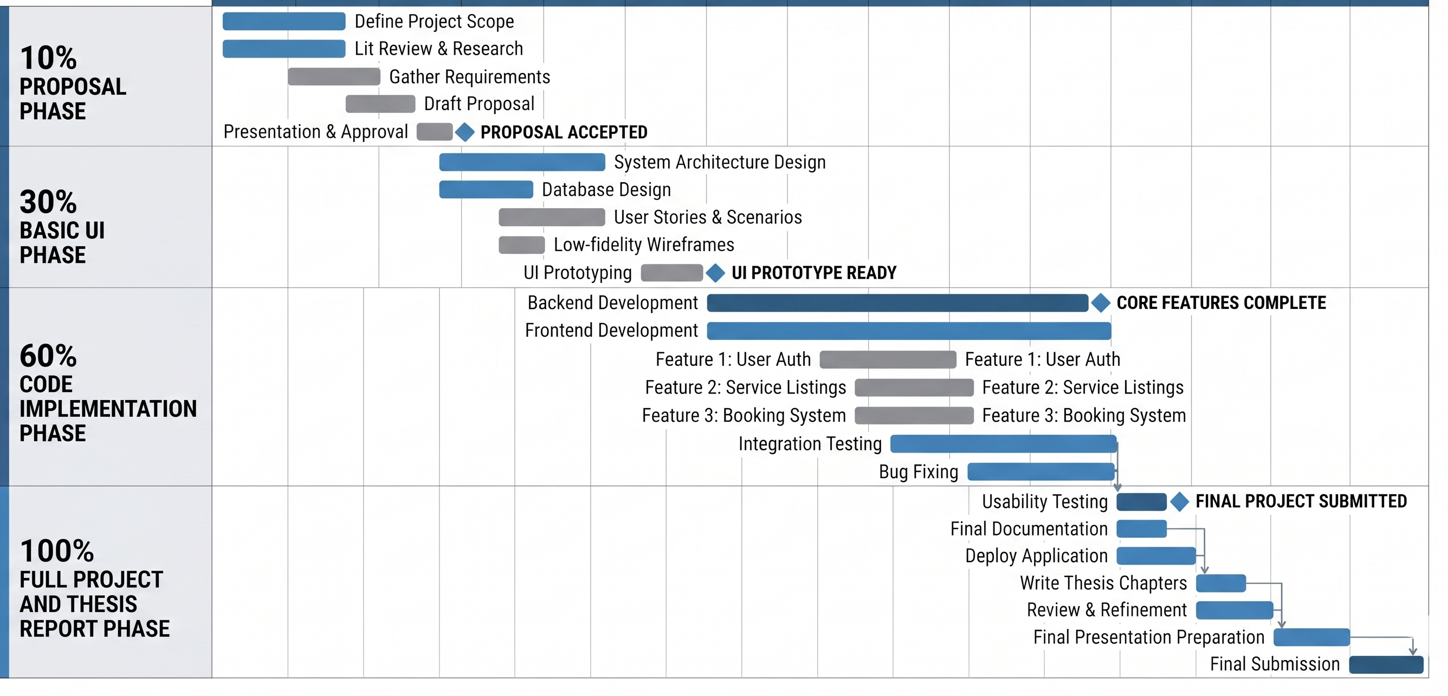
Schedule

Slide 24
Details of 1st Iteration (30%)
Complete system architecture design and ERD documentation.
Design the initial database schema aligned with system entities.
Architecture: Set up the Flutter project structure, application theme tokens, and custom reusable widgets.
Navigation: Built an interactive routing controller to test all user journeys seamlessly.
Auth UI: Built Splash, Onboarding, Role Selection, Sign In, and Sign Up screens with validation.
Household UI: Built home search, worker search lists, worker details, and rating/review screens.
Booking UI: Built booking forms, auto-generated service agreements, and complete booking histories.
Worker UI: Built a worker metrics dashboard and weekly availability management screens.
Support UI: Built notifications log screens and a dispute filing screen.

Slide 25
Details of 2nd Iteration (60%)
1. Supabase Backend & Database Setup
PostgreSQL Schema: Create all 14 tables (Users, Profiles, Bookings, Availability, Disputes, etc.) in Supabase.
File Storage: Set up Supabase Storage buckets for worker ID card (CNIC) and document verification uploads.
2. User Authentication & Role Flow
Live Sign-In/Up: Connect Flutter auth screens to Supabase Auth (Sign In, Sign Up, and password recovery).
Role Routing: Implement a persistent session state that reads the user's role (Household or Worker) from database metadata and directs them to the correct dashboard.
3. Mobile UI & Database Integration
Profile Integration: Sync household and worker screens with database profile tables so updates are saved permanently.
Availability Planner: Bind the worker availability UI to AVAILABILITY_SLOTS database operations.
Booking System: Implement the live Send Request flow between Household and Worker apps.

Slide 26
Details of 2nd Iteration (60%)
4. Core Algorithms Implementation
Geographical Search Query: Write the PostgreSQL search function to find nearby workers by calculating distance/proximity and sorting by rating/experience.
Double-Booking Prevention: Build check logic that blocks booking requests if the time slot conflicts with the worker's existing bookings.
Dispute and Agreement Generator: Automate the creation of PDF/text service agreements when bookings are accepted, and handle dispute filing states.
5. Notifications & Alerts
Triggers: Set up database triggers or notifications using Supabase Edge Functions to alert users of booking status changes
6. Admin Web Dashboard
Admin Portal: Set up the React web application shell and connect it to the same Supabase backend.
Admin Flows: Implement verification dashboards (reviewing and approving/rejecting worker profiles) and booking oversight tables.

Slide 27
Conclusion
HomeEase successfully modernizes Pakistan's informal domestic worker sector by replacing word-of-mouth hiring with a structured, hyper-local mobile platform. Built using Flutter, React/Vite, and Supabase, the system enables households to easily find nearby verified workers (such as maids, cooks, and cleaners) through real-time booking, double-booking prevention, and location-based filtering.
By digitalizing profile verifications, service agreements, and ratings, the platform solves core trust and safety issues for households. Simultaneously, it empowers domestic workers with digital visibility, structured schedules, and a reputation-building rating system, establishing a secure and organized domestic gig economy.

